Slide 1
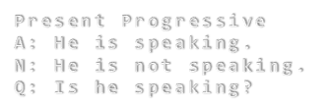
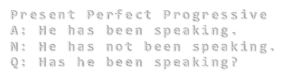
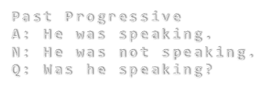
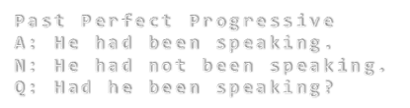
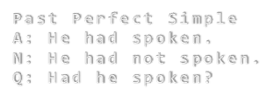


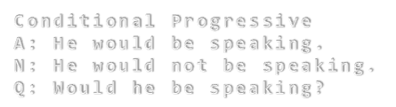

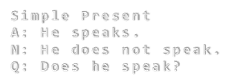
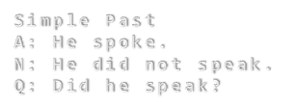

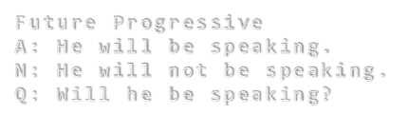
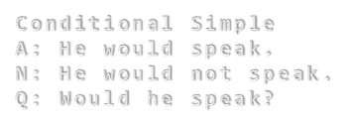
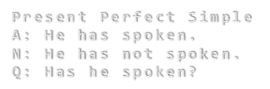
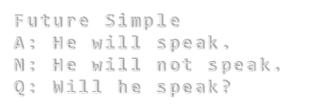


Slide 2

change in pitch or tone of voice.
Tense [těns]
A category of verbal inflection expressing the time at, during, or over which a state or action denoted by a verb occurs.

Slide 3
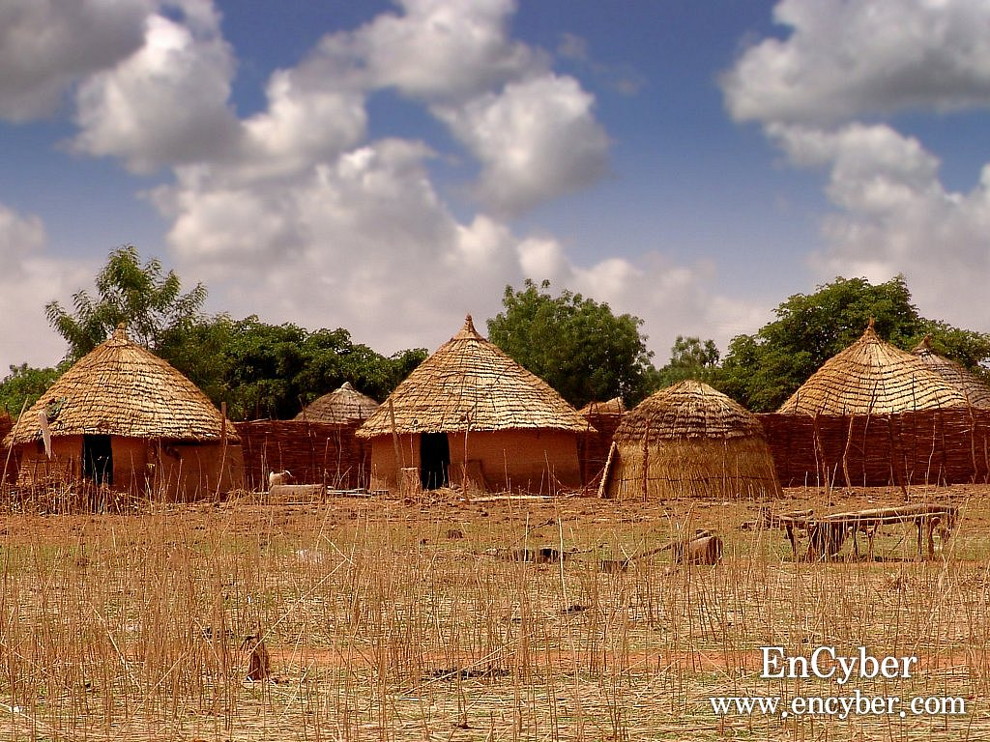
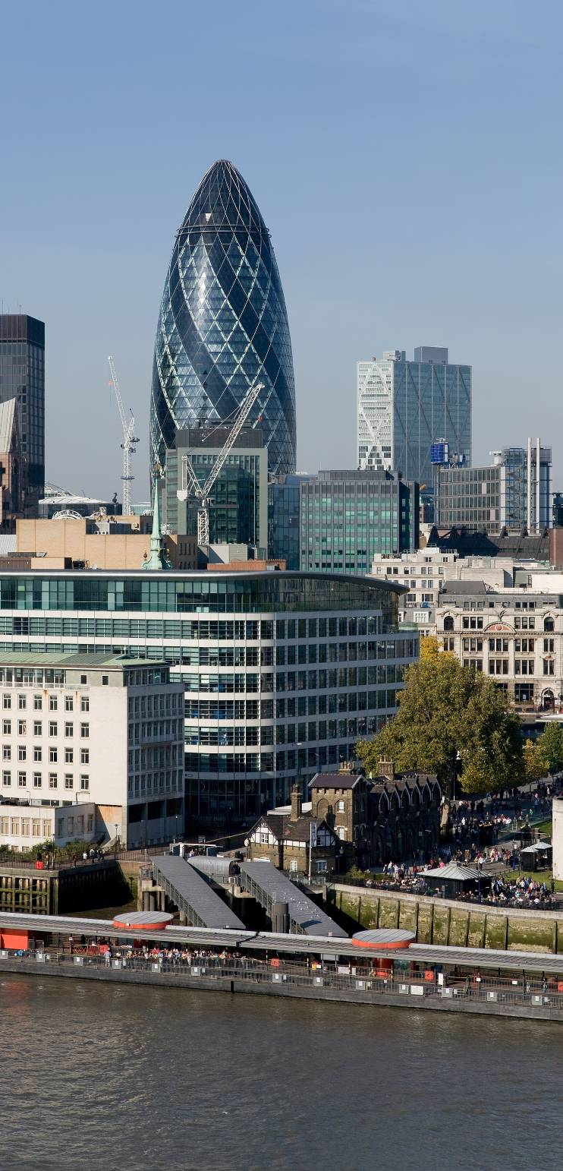
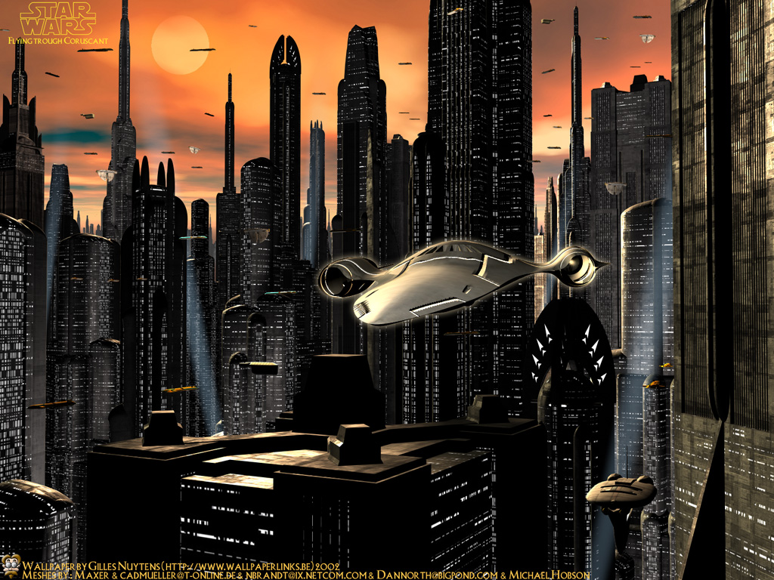
Past Present Future

Slide 4
Past tense expresses action, activity and state of being in the past

Slide 5
Simple Past expresses the idea that an action started and finished at a specific time in the past.

Slide 6
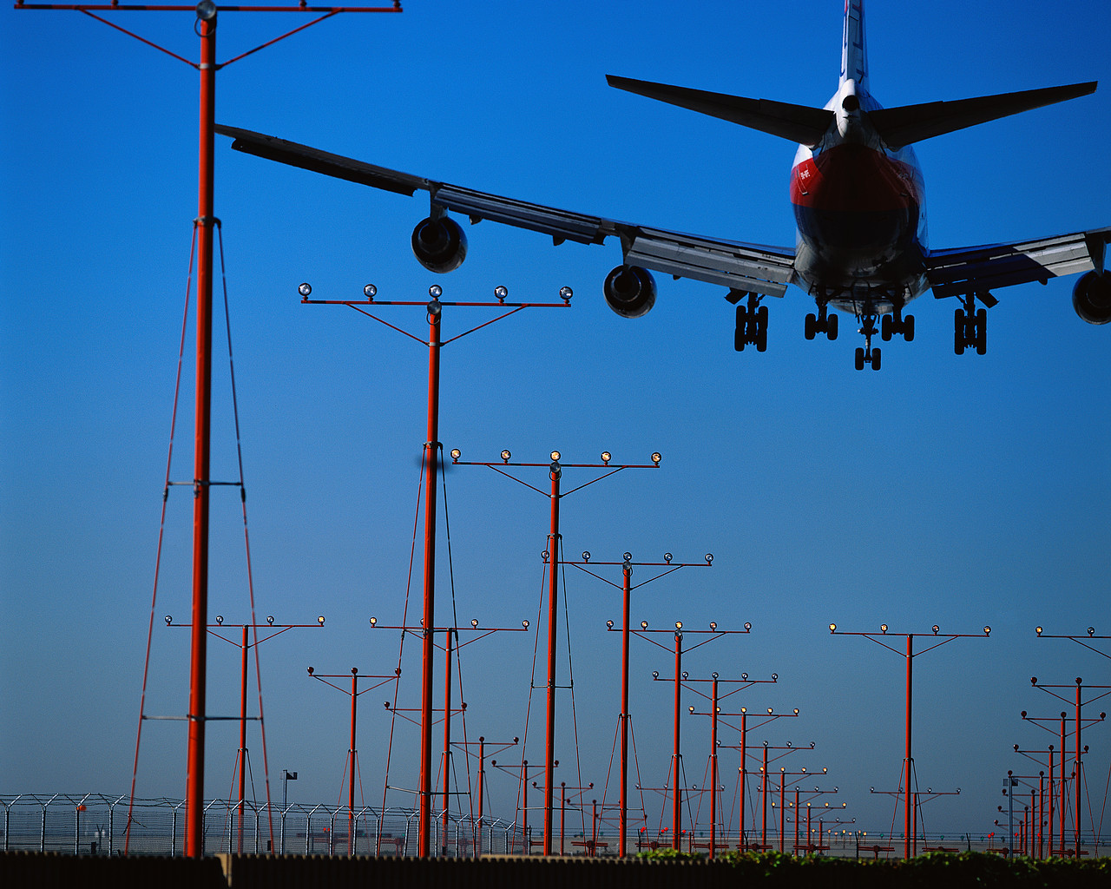
Henry arrived at the airport.
Past
Present
Future
Completed action in the past

Slide 7
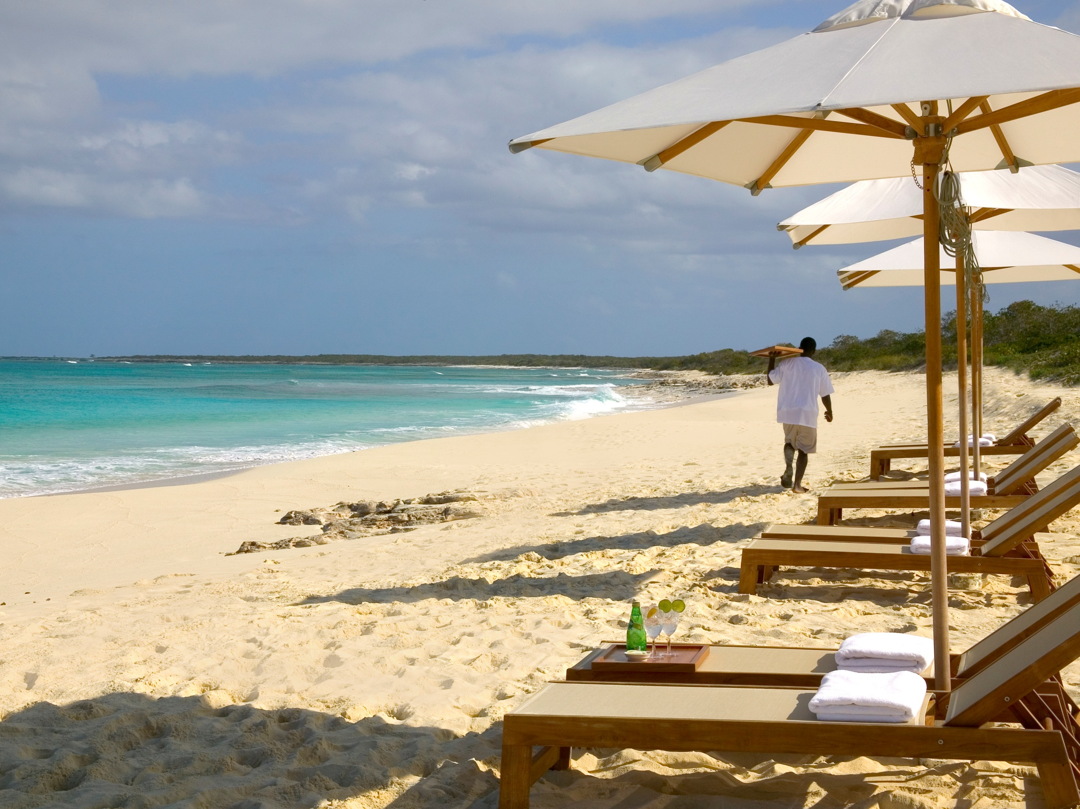
I finished my lunch, went to the beach, and found a nice place to swim.
Past
Present
Future
A series of completed actions

Slide 8
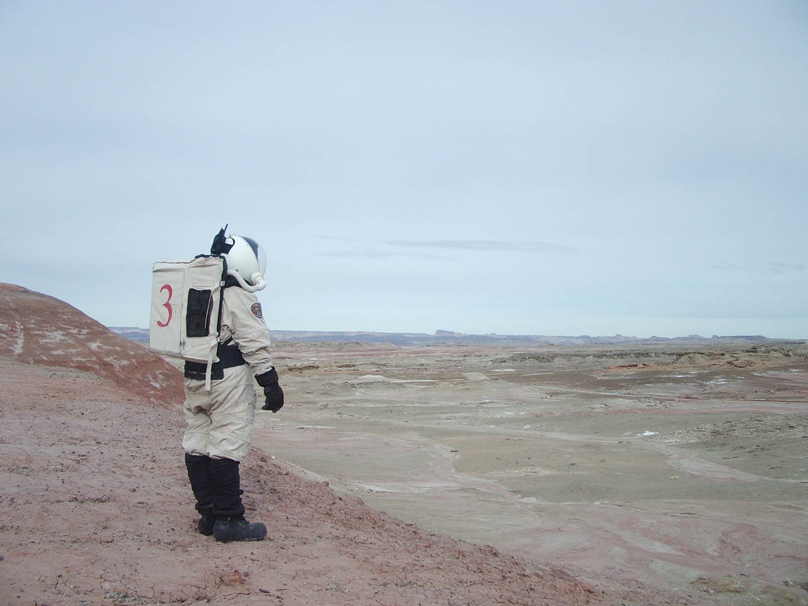
Richard studied astronautical engineering for three years.
Past
Present
Future
Duration in the past

Slide 9

Eric was shy as a child, but now he is very outgoing.
Past
Present
Future
Past Facts or Generalizations

Slide 10
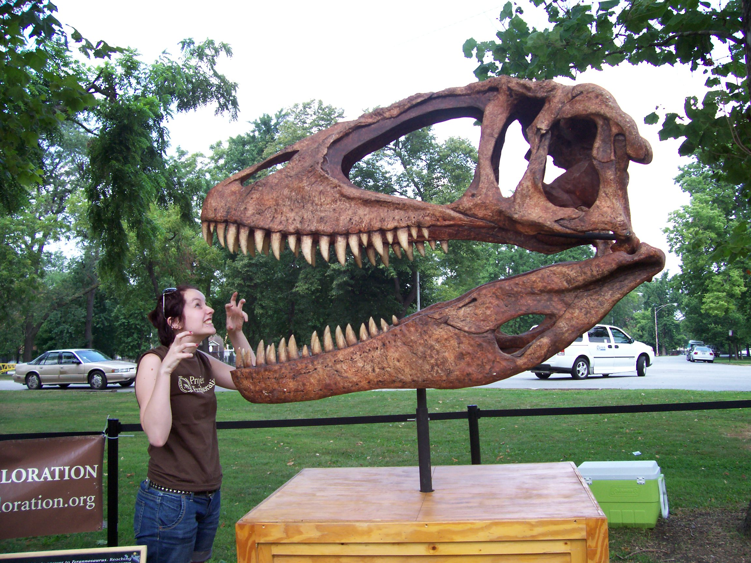
Dinosaurs were once the dominant terrestrial vertebrate animals.
Past
Present
Future
Past Facts or Generalizations

Slide 11
When-Clauses
Always happen first

Slide 12
When-Clauses
They can be positioned at beginning or at the end of a sentence

Slide 13
When-Clauses
She answered my question when I paid her one dollar.
When I paid her one dollar, she answered my question.

Slide 14
pay then answer
When-Clauses
She answered my question when I paid her one dollar.
When I paid her one dollar, she answered my question.

Slide 15
When-Clauses
She answered my question when I paid her one dollar.
I paid her one dollar when she answered my question.

Slide 16
pay then answer
When-Clauses
She answered my question when I paid her one dollar.
I paid her one dollar when she answered my question.
answer then pay

Slide 17
Use Past Continuous to indicate that a longer action in the past was interrupted. The interruption is usually a shorter action in the Simple Past.

Slide 18
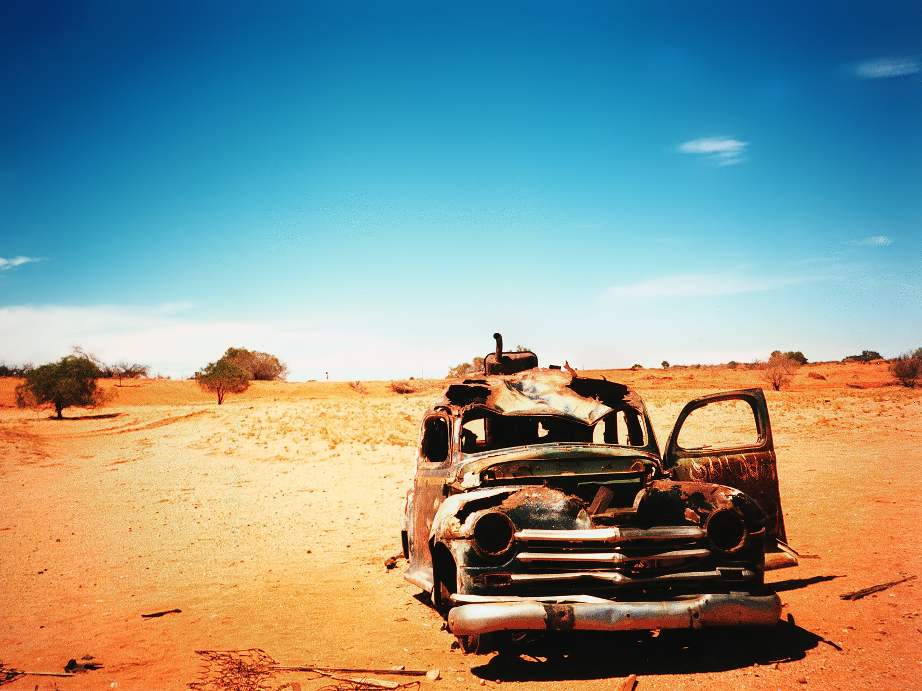
We were driving through the desert when our car suddenly broke down.
Past
Present
Future
Interrupted action in the past

Slide 19
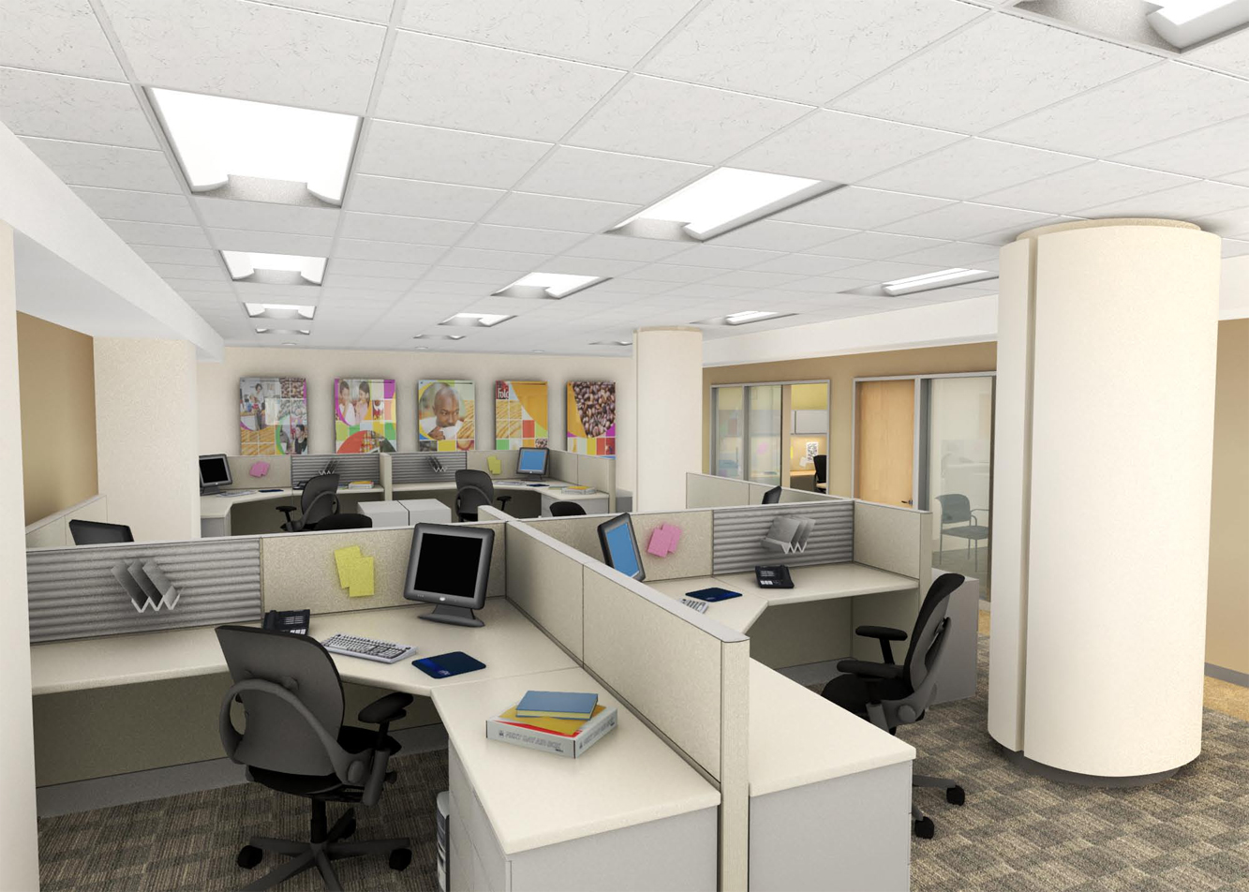
When I walked into the office, several people were busily typing, some were talking on the phones, the boss was yelling, and customers were waiting to be helped.
Past
Present
Future
Parallel actions

Slide 20
Present tense expresses action, activity and state of being in the present

Slide 21
Use the Simple Present to express the idea that an action is repeated or usual.

Slide 22
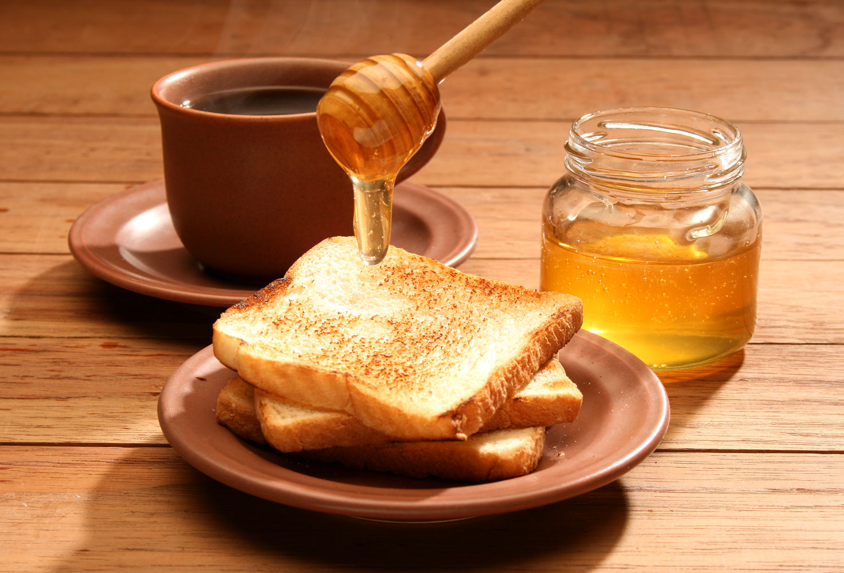
I eat breakfast every morning at 6:30. I go to work every day.
Past
Present
Future
Repeated Actions

Slide 23

The earth revolves around the sun.
Past
Present
Future
Facts or Generalizations

Slide 24
Use the Present Continuous with Normal Verbs to express the idea that something is happening now, at this very moment. It can also be used to show that something is not happening now.

Slide 25

Past
Present
Future
Actions in progress now
I am sitting down, because I am tired.

Slide 26

Past
Present
Future
Actions happening around now,
and not necessarily this very moment
Sally is studying really hard for her exams this week.

Slide 27

Past
Present
Future
Near future
I am seeing my dentist on Wednesday.

Slide 28
She is loving this chocolate ice cream.
✖

Slide 29
It is important to remember that Non-Continuous Verbs cannot be used in any continuous tenses. Also, certain non-continuous meanings for Mixed Verbs cannot be used in continuous tenses. Instead of using Present Continuous with these verbs, you must use Simple Present.
She loves this chocolate ice cream.

Slide 30
Non-Continuous Verbs are usually things you cannot see somebody doing. These verbs are rarely used in continuous tenses.
Abstract Verbs
to be, to want, to cost, to seem, to need, to care, to contain, to owe, to exist...
Possession Verbs
to possess, to own, to belong...
Emotion Verbs
to like, to love, to hate, to dislike, to fear, to envy, to mind…

Slide 31
Mixed Verbs have more than one meaning. In a way, each meaning is a unique verb. Some meanings behave like "Non-Continuous Verbs," while other meanings behave like "Normal Verbs."
Mixed Verbs
to appear, to feel, to have, to hear, to look, to see, to weigh...

Slide 32
Use Present Perfect to express action that has been completed with respect to the present.

Slide 33
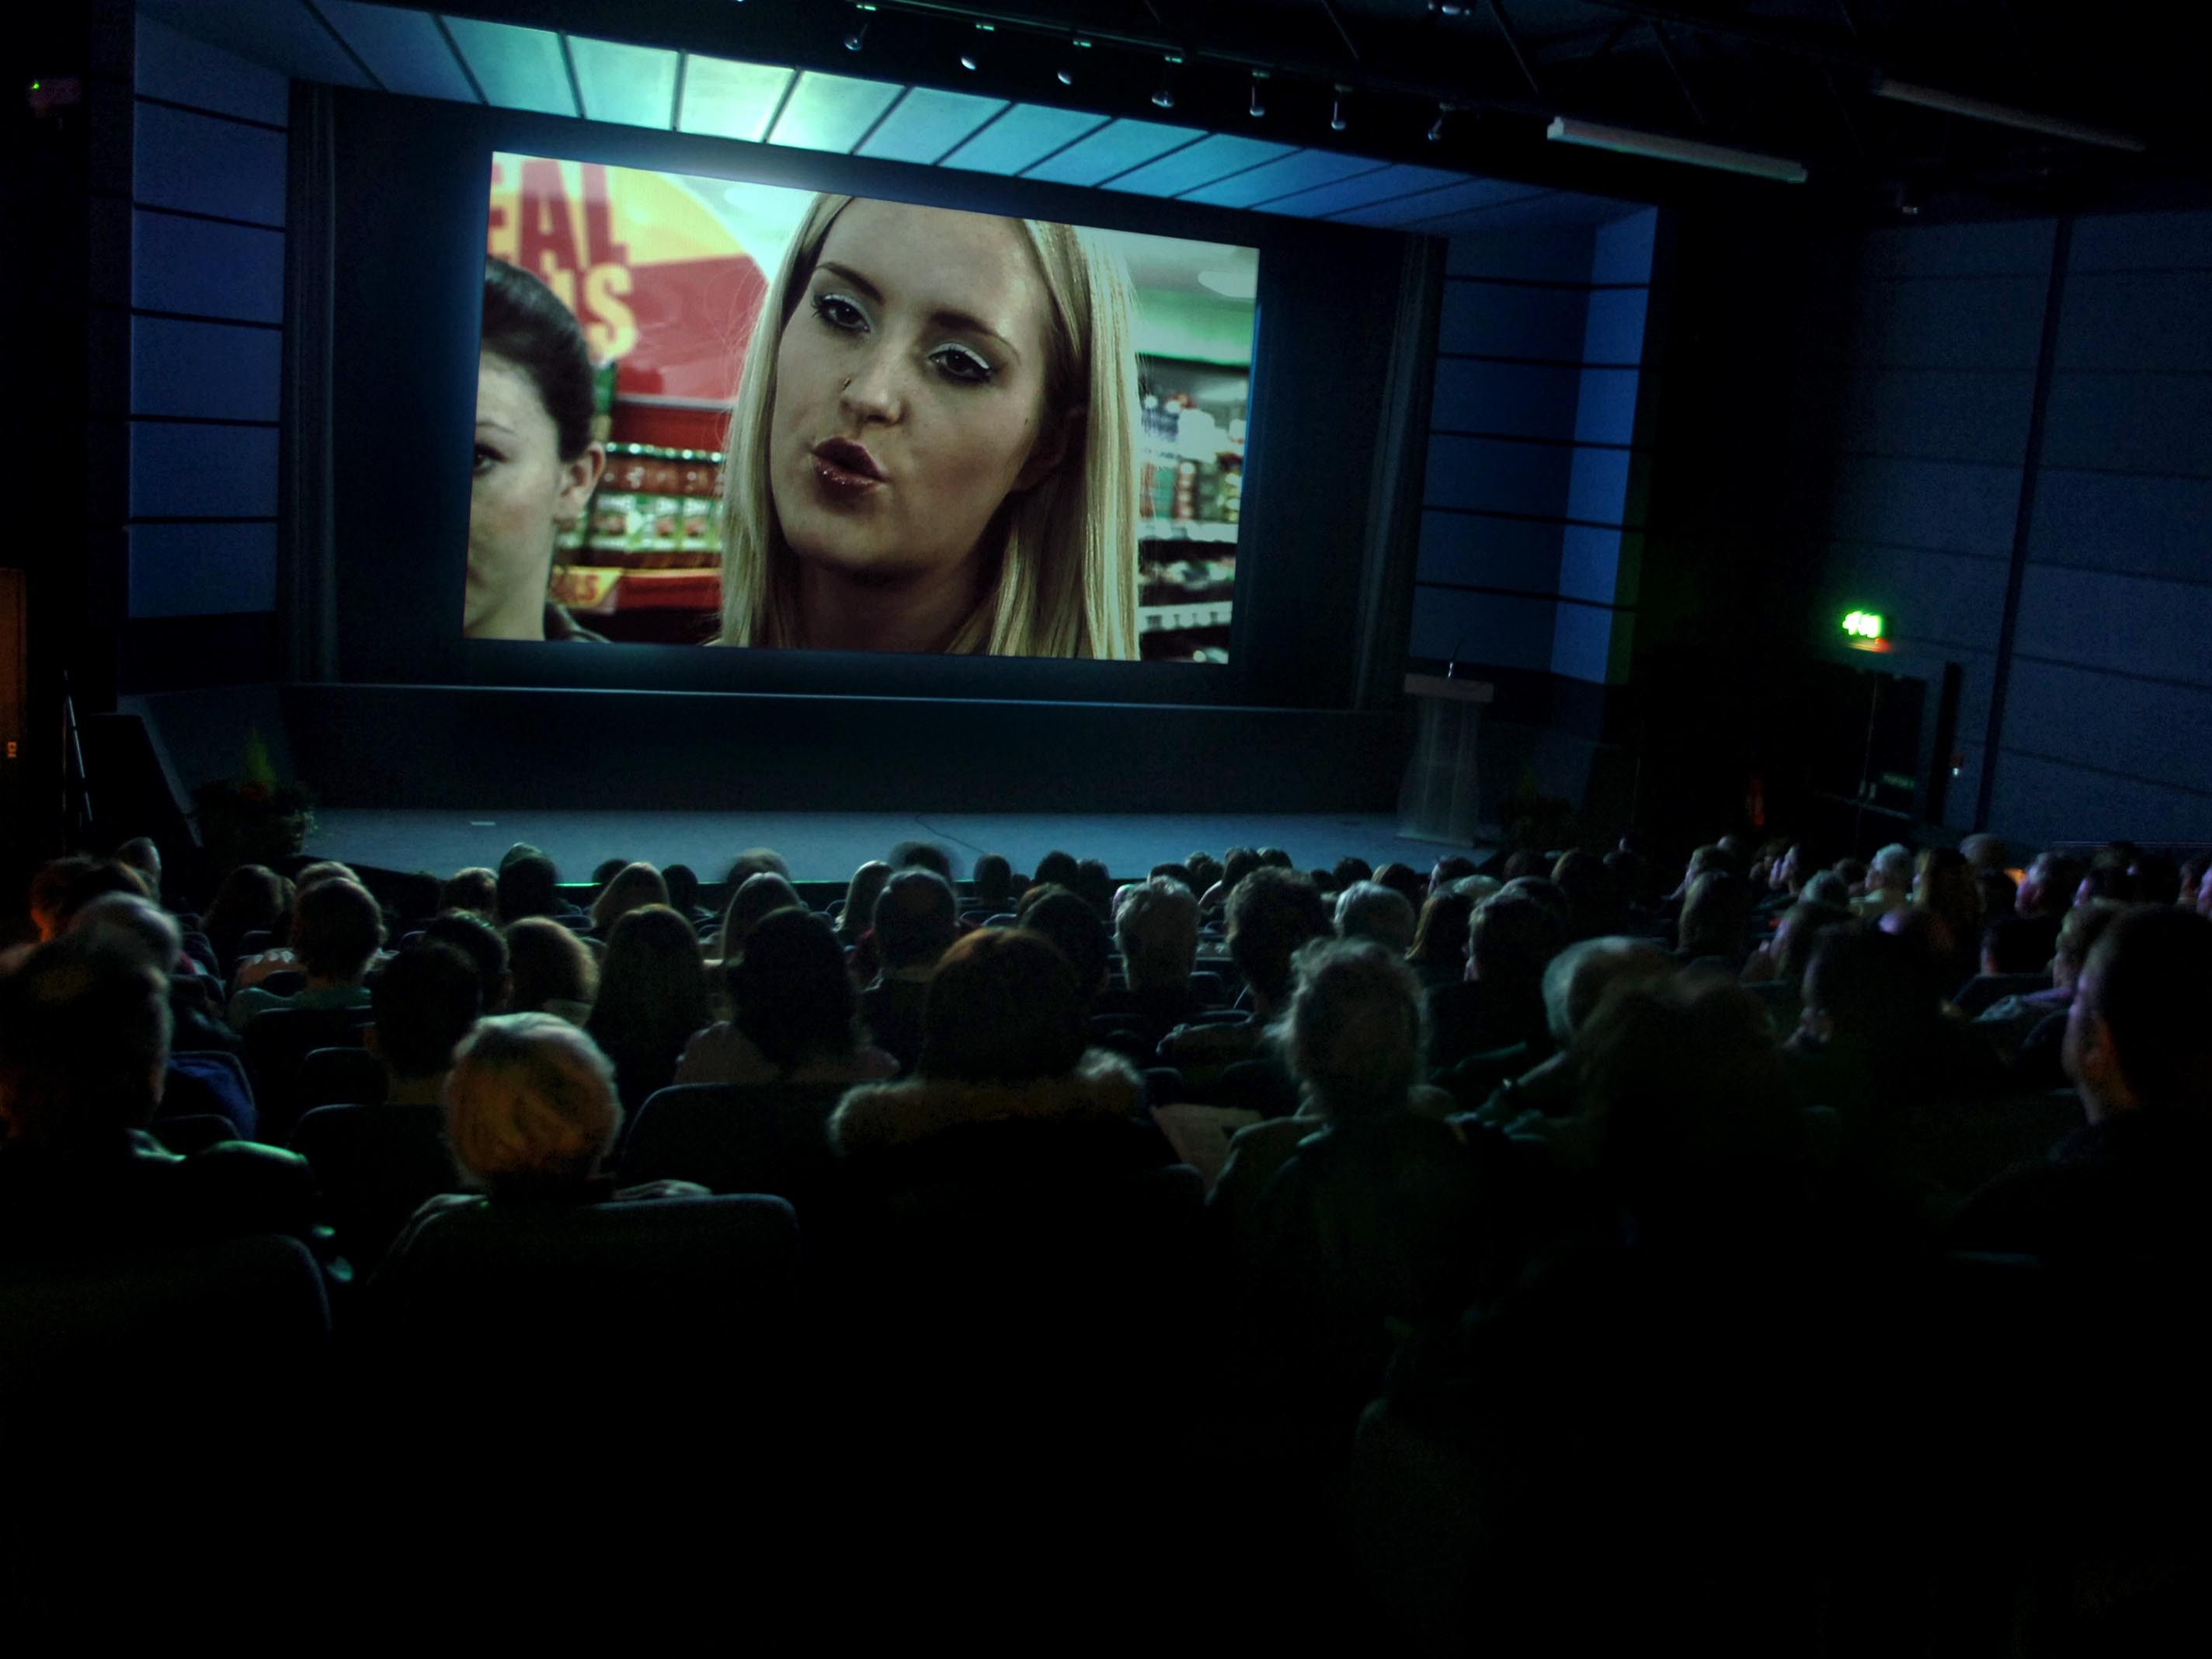
Past
Present
Future
Unspecified time before now
I have already seen that film. I do not want to see it again.

Slide 34
I went to Mexico last year.

Slide 35
I went to Mexico in the calendar year before this one.
I went to Mexico last year.

Slide 36
I have been to Mexico in the last year.

Slide 37
I have been to Mexico at least once at some point between 365 days ago and now.
I have been to Mexico in the last year.
"Last year" and "in the last year" are very different in meaning. "Last year" means the year before now, and it is considered a specific time which requires Simple Past. "In the last year" means from 365 days ago until now. It is not considered a specific time, so it requires Present Perfect.

Slide 38
Use Present Perfect or Present Perfect Continuous to refer to an event that may or may not be finished when its effect can be seen now.

Slide 39
Richard has studied astronautical engineering for three years.
Past
Present
Future
Duration in the past until now

Slide 40
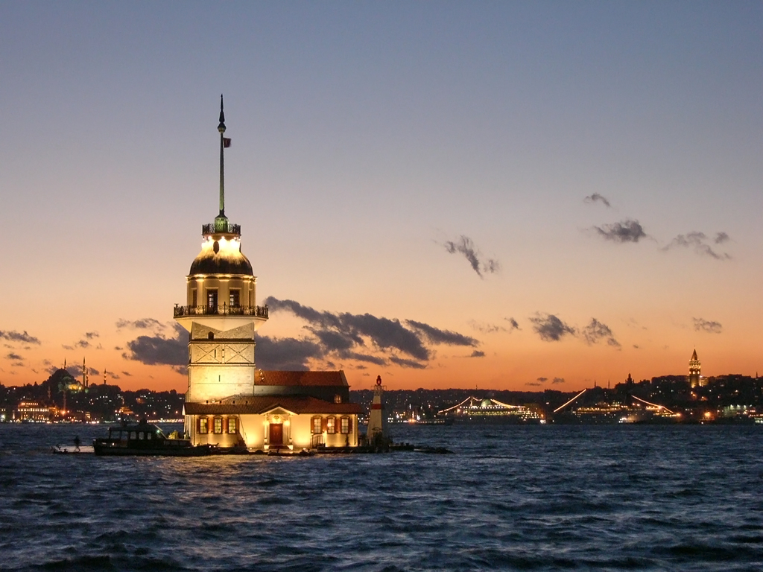
Tony has lived in Istanbul since 2007.
Past
Present
Future
Duration from the past until now

Slide 41
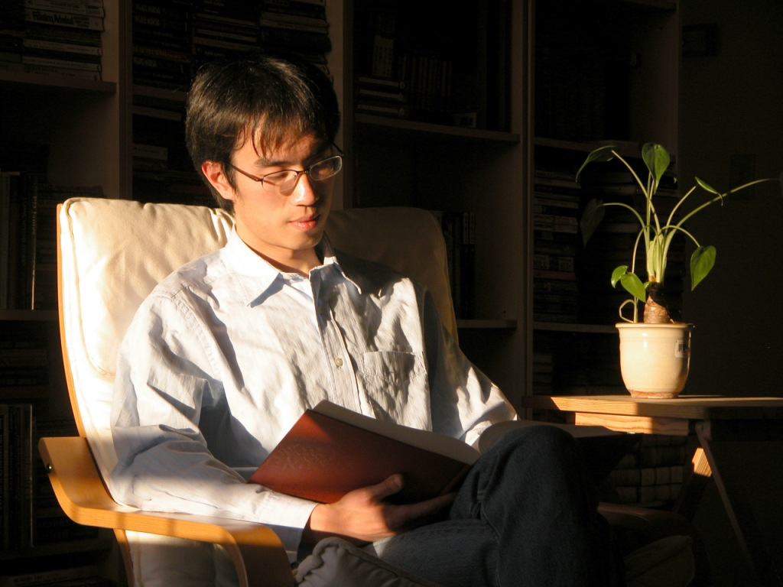
Wang has been a student at ITCG Fermi for over two years.
Past
Present
Future
Duration from the past until now

Slide 42
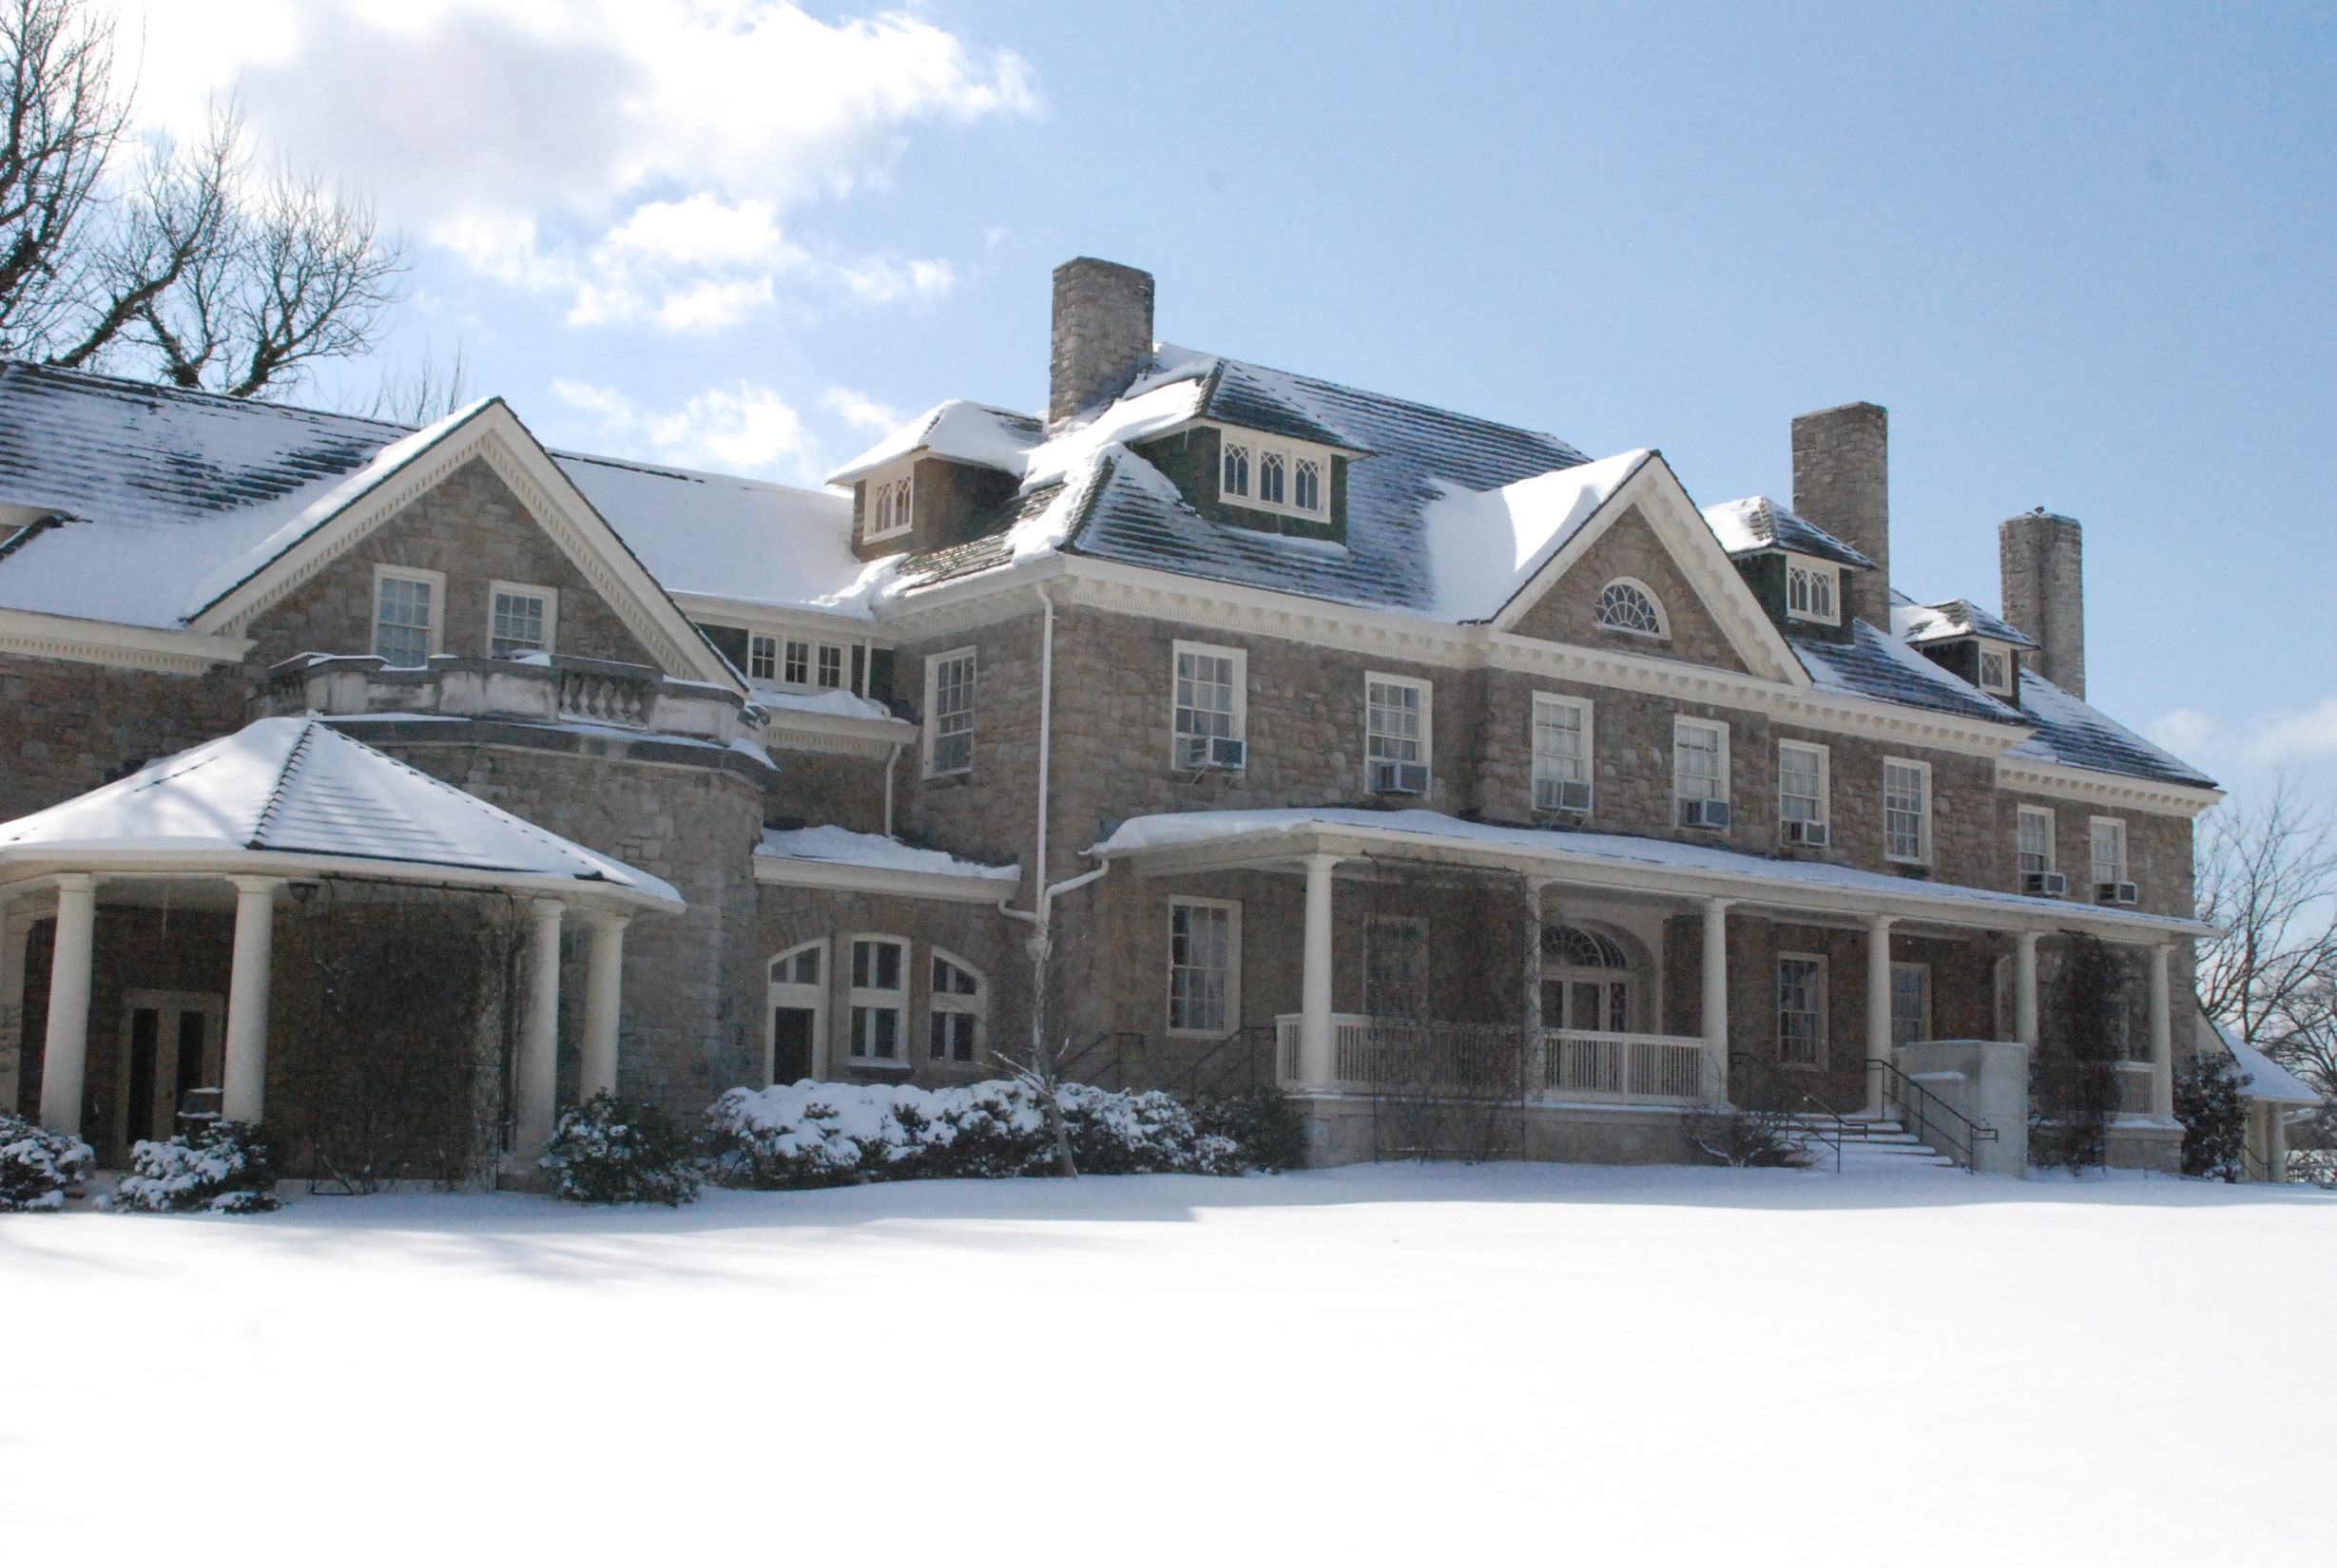
Past
Present
Future
Duration from the past until now
Look! It has been snowing.

Slide 43

Sam has been having his car for two years.
✖

Slide 44
It is important to remember that Non-Continuous Verbs cannot be used in any continuous tenses. Also, certain non-continuous meanings for Mixed Verbs cannot be used in continuous tenses. Instead of using Present Perfect Continuous with these verbs, you must use Present Perfect.
Sam has had his car for two years.

Slide 45
Future tense expresses action, activity and state of being in the future

Slide 46
Simple Future has two different forms in English: "will" and "be going to." Both "will" and "be going to" refer to a specific time in the future.

Slide 47
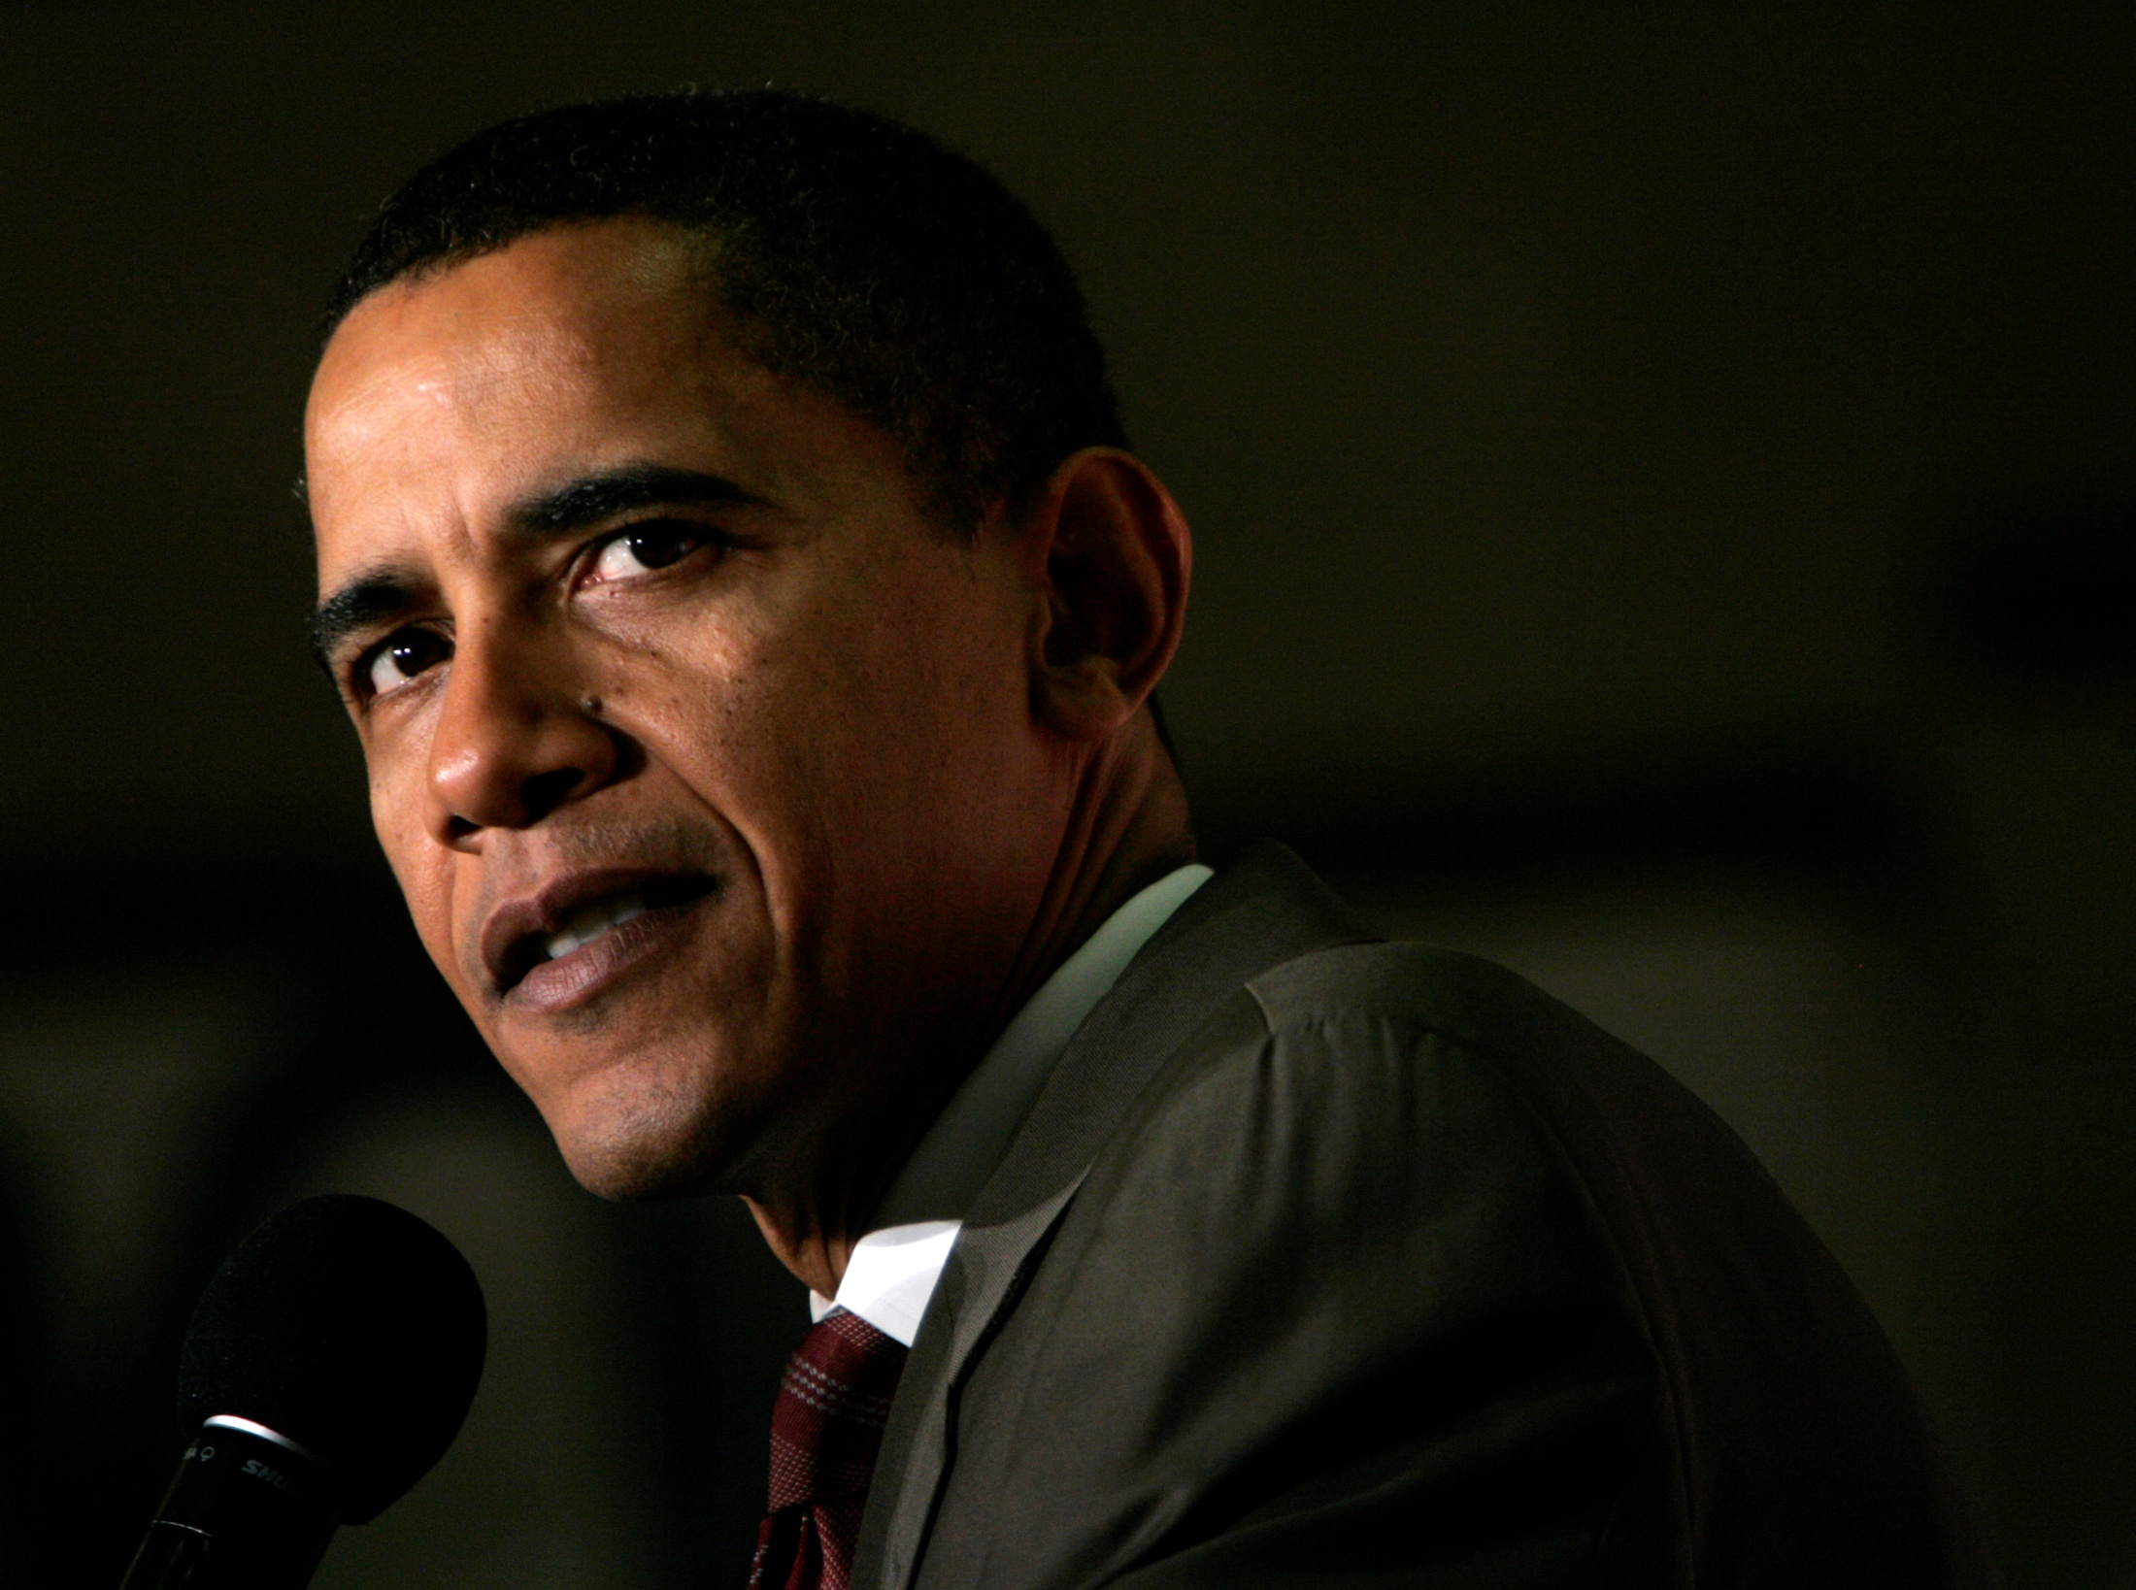
If I am elected President of the United States, I will make sure everyone has access to inexpensive health insurance.
Past
Present
Future
"Will" to express a promise

Slide 48
When you will arrive tonight, we will go out for dinner.
✖

Slide 49
No Future in Time Clauses
Like all future forms, the Simple Future cannot be used in clauses beginning with time expressions such as: when, while, before, after, by the time, as soon as, if, unless, etc. Instead of Simple Future, Simple Present is used.
Correct sentences:
When you arrive tonight, we will go out for dinner.
If you come on time, we will go out for dinner.
If you are tired, we won’t go out.
We will go out for dinner, unless you are too tired.

Slide 50

English Page
http://www.englishpage.com/verbpage/verbtenseintro.html
English Grammar Reference and Exercises
http://www.ego4u.com/en/cram-up/grammar
Play with the Irregular Verb Wheel:
http://www.macmillandictionary.com/verb_wheel/
References

